Slide 1
Housing prices in NYC
Which zipcodes have the best ROI?

Slide 2
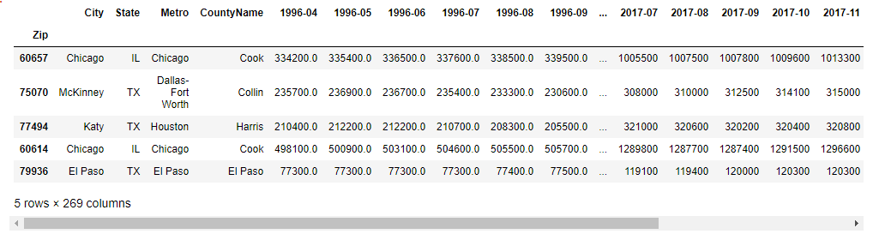
The zipcode-price dataset
This dataset contains the month-by-month median price of all the properties in the listed zipcodes, going from 1996 to 2018.

Slide 3

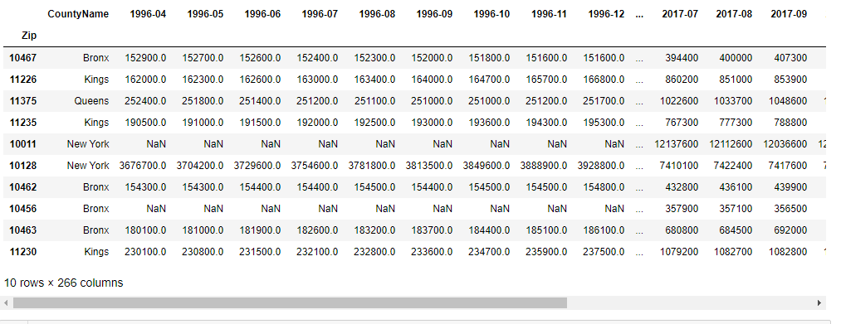
NYC zipcodes
For the sake of tractability, we will first start by only looking at NYC zipcodes

Slide 4
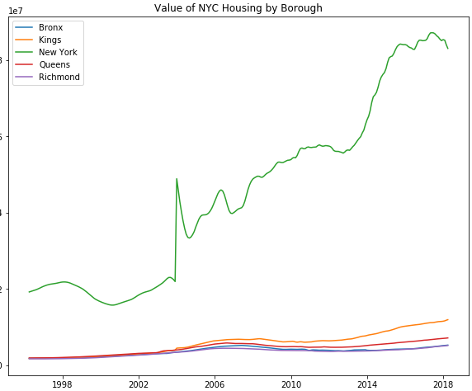
Graphs by borough
As we can see, Manhattan is clearly the most expensive borough, with the rest looking about the same. However, Manhattan seems to be dropping recently while the rest have a small incline!

Slide 5
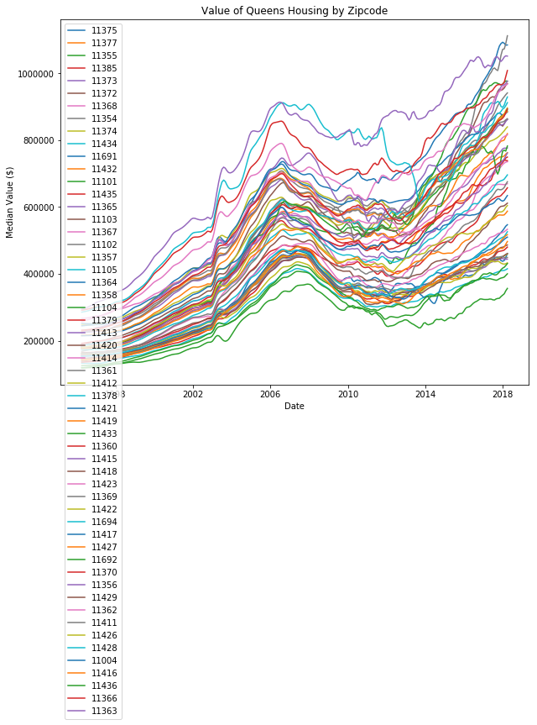
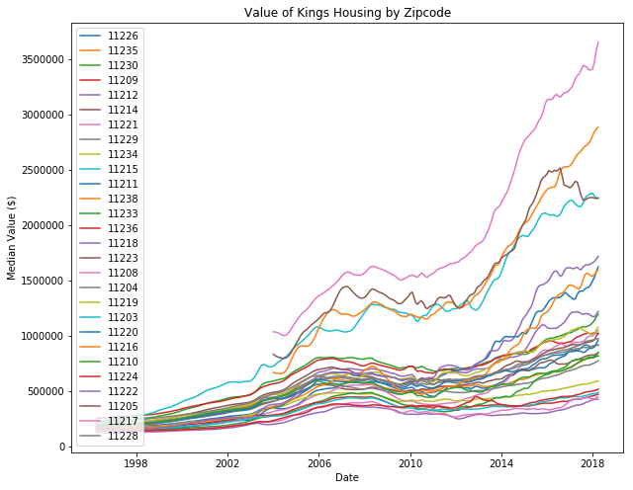
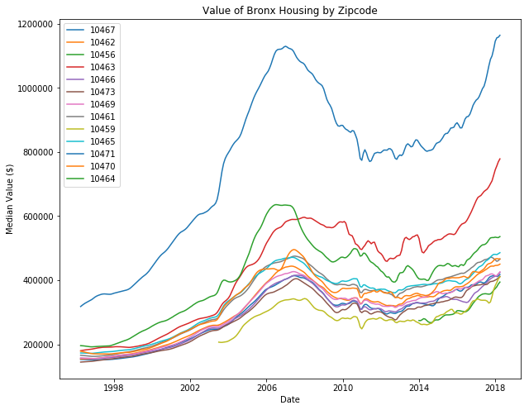
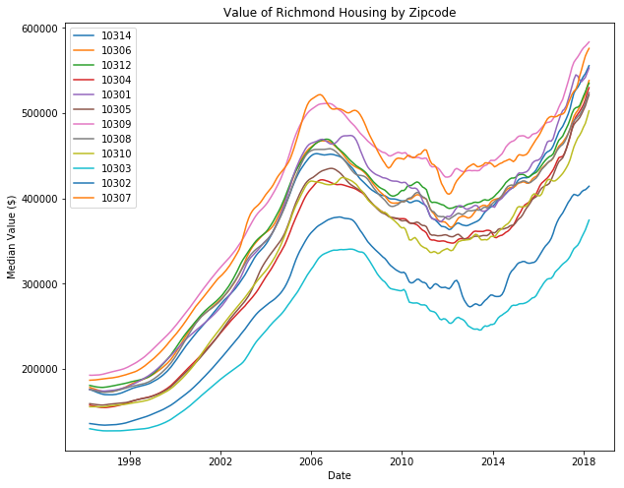
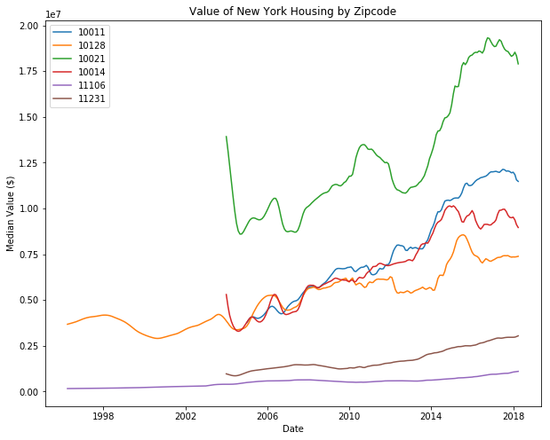
Lets see how each borough looks subdivided by zip

Slide 6
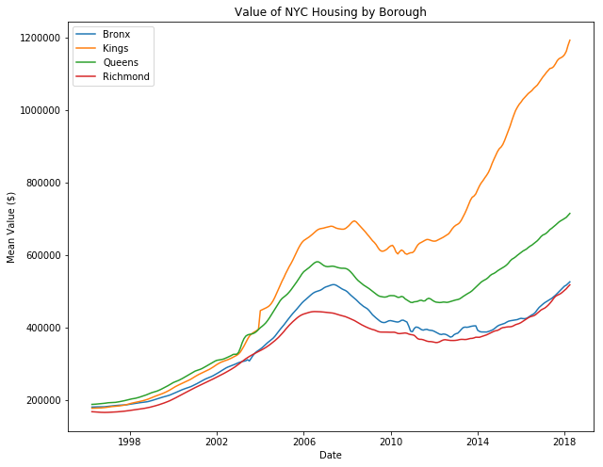
Manhattan is stagnant
The other four boroughs are all soaring in price, while Manhattan doesn’t seem to be increasing at all.

Slide 7
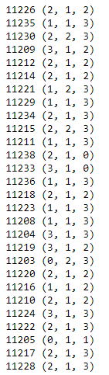
Best zipcodes in Brooklyn
There are too many zipcodes to analyze in all NYC. Only Brooklyn will be considered for this project. Here are the pdq ARIMA results for each zipcode:

Slide 8
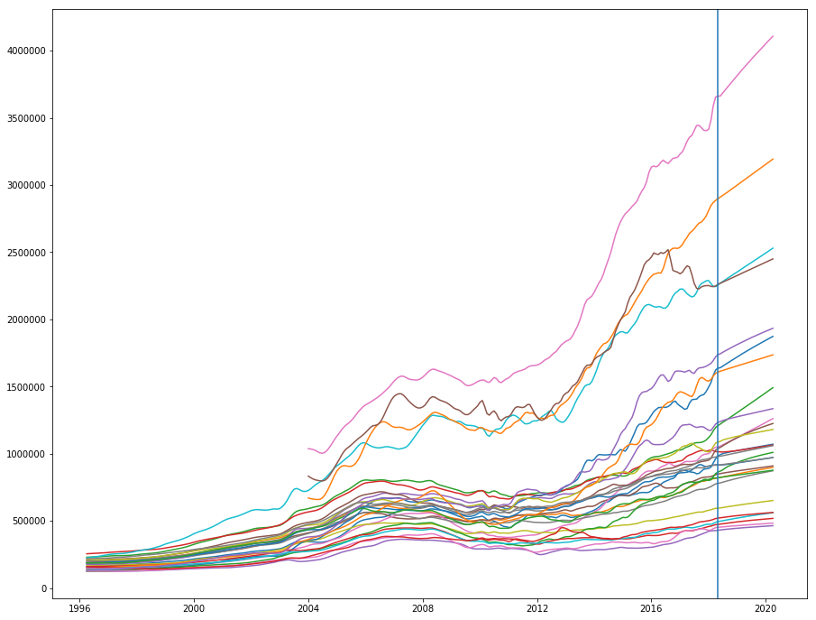
Model forecast
This simple model predicts a straight line increase for each zipcode. It lacks the bumpiness seen in real data. Perhaps SARIMA would fix this. Also worth considering using pdq ranges beyond 3.

Slide 9
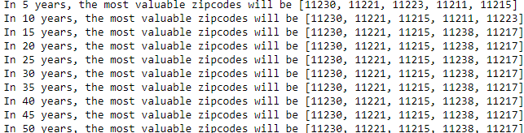
Final ROIs
Presented are the best zipcodes to invest in based on short vs long term goals

